Slide 1
HEALTH PRINCIPLES

Slide 2
CELEBRATIONS
From the initial Mmterial of the Health Ministries Department. General Conference of Seventh-day Adventists

Slide 3
CHAPTER ONE
CHOICES

Slide 4
CELEBRATIONS
C: CHOICES
E: EXERCISES
L: LIQUIDS
E: ENVIRONMENT
B: BELIEF
R: REST
A: AIR
T: TEMPERANCE
I: INTEGRITY
O: OPTIMISM
N: NUTRITION
S: SOCIAL SUPPORT

Slide 5
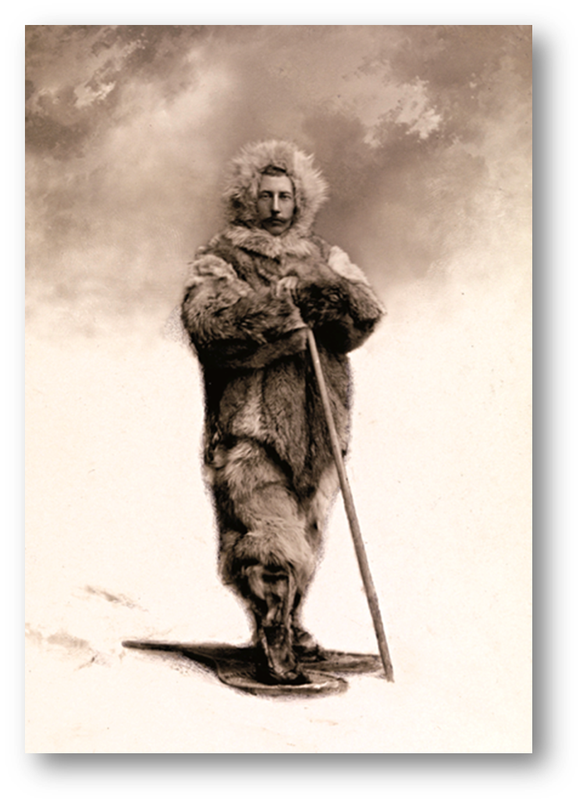
Roald Amundsen
Once made, the decision presented them with countless choices: selecting the clothing to wear, the food to eat, and, most important, the mode of transport. Roald Amundsen, the Norwegian explorer, gleaned from Inuit methodology the best type of equipment and clothing to use.
Notes:
Some 100 years ago two team leaders adopted the same goal: they both sought to be the first to lead an expedition to the South Pole.
Once made, the decision presented them with countless choices: selecting the clothing to wear, the food to eat, and, most important, the mode of transport. Roald Amundsen, the Norwegian explorer, gleaned from Inuit methodology the best type of equipment and clothing to use.

Slide 6
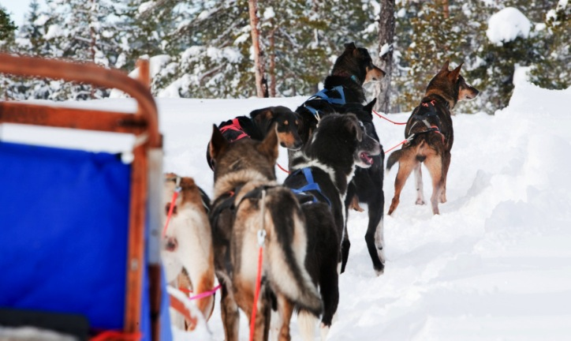
He carefully considered every detail
He chose dogs to pull the sleds. He placed his supplies and foodstuffs strategically along the early part of the proposed route to travel before the main expedition set off, thereby lessening the loads his dogs would have to pull. He carefully considered every detail, and from his informed base he made decisions as to how to proceed.
Notes:
He chose dogs to pull the sleds. He placed his supplies and foodstuffs strategically along the early part of the proposed route to travel before the main expedition set off, thereby lessening the loads his dogs would have to pull. He carefully considered every detail, and from his informed base he made decisions as to how to proceed.

Slide 7
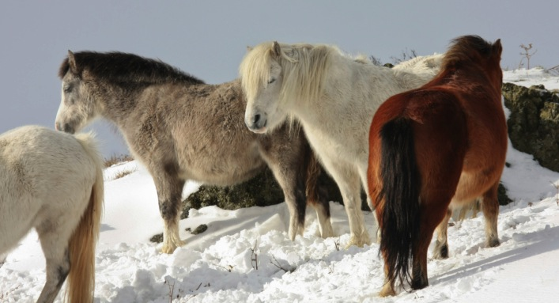
Robert Falcon Scott chose to use ponies and modern motorized sleds
Notes:
Robert Falcon Scott, however, a British naval officer, chose to use ponies and “modern” motorized sledges. He was a brave and daring man, but apparently did not pay the same attention to Inuit methodology as did Amundsen. His motorized sleds ceased functioning after a few days, and the ponies could not stand the frigid conditions. By the time he and his team reached the Transantarctic Mountains, the ponies were in such poor condition they had to be killed. Scott arrived at the South Pole to find that Amundsen had beaten him to the goal.

Slide 8
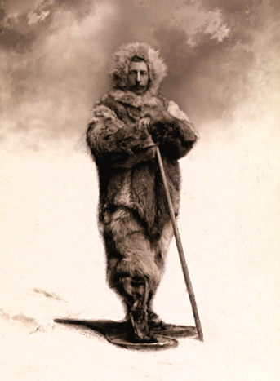
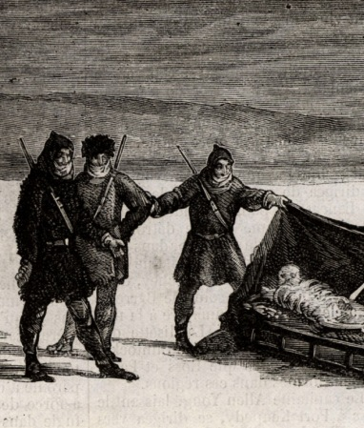
Amundsen and Scott represented choices
Notes:
The outcome for one team was triumph; for the other, death and disaster. The diaries of Scott’s heroic team chronicled a story of frostbite, starvation, and eventually death on the return journey from the pole.
Decisions made or neglected by Amundsen and Scott represented choices. Some were made very consciously and intentionally; others were possibly influenced by emotion, personality, culture, or whim. Brave and courageous though Scott and his men were, they suffered the consequences of their choices and decisions, perhaps made in ignorance, but nevertheless lethal in outcome.¹

Slide 9
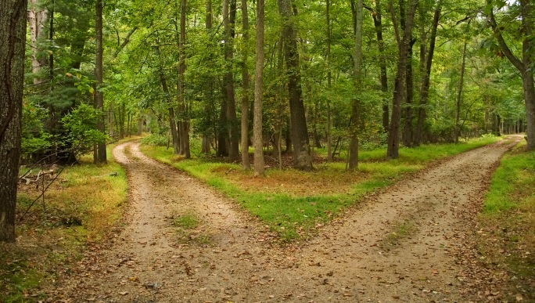
Choices –the cradle of destiny
Notes:
Choices often determine our destiny. To a large extent even our health can be determined by the choices we make on how we live, the risks we take, and the balance we seek in life. We each come into the world with an endowment for health that may vary from that of others, but how we care for the gift of our health influences the expression of our genetic capacities.

Slide 10
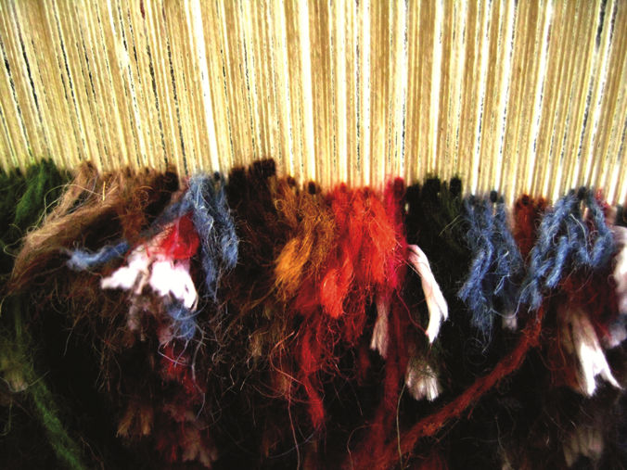
Our lives are patterned in a similar way
Notes:
The intricacies of handmade Asian rugs are remarkable and often represent hundreds of thousands and sometimes even millions of individual choices. For those rugs with 800 hand-tied knots per square inch, the maker has to select a colored thread to create the pattern 800 times. In the overall pattern, the subtle variety in the shapes making up the whole speaks to the individuality of each knot.
Our lives are patterned in a similar way. Every day we make countless seemingly insignificant decisions, the sum of which determines the overall fabric of our lives.

Slide 11

Intentionality is key
Intentionality in decision-making brings direction and order to our lives. Successful people generally set goals and objectives; highly successful individuals make evidence-based decisions that move them deliberately toward those goals.
Notes:
Intentionality in decision-making brings direction and order to our lives. Successful people generally set goals and objectives; highly successful individuals make evidence-based decisions that move them deliberately toward those goals.

Slide 12
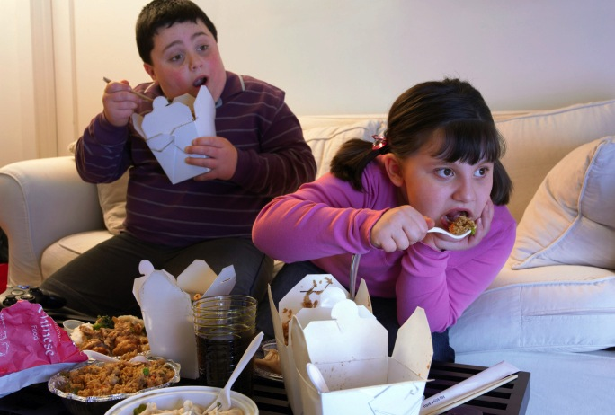
Decisions made in youth…
Notes:
Unfortunately, some decisions made in youth—as a result of ignorance, rebellion, or stubbornness—can have lifelong repercussions. Similarly, poor parenting practices can encumber children with a lifetime of consequences. In many cases the current epidemic of obesity in children in the Western world reflects parental resignation to allowing too much electronic entertainment at the expense of physical activity. Fast and convenient foods replace simple, unrefined, natural foods. The immediate gratification of fast, oily, and high-calorie foods pleases both parents and children, but the consequences of such choices may last a lifetime. Once formed, fat cells persist for years, awaiting excess calories to be stored as fat. Chubby children are obese adults-in-waiting. The fat baby carries a legacy for life that perhaps reflects the parental inability or unwillingness to control caloric intake. Conscious intentionality is an important part of making such choices.

Slide 13

Choice and freedom
Choice and freedom are closely linked. Many correctional services seek to discipline by limiting available choices. In most societies even the greatest of freedoms permits only the choices that do not negatively impact others, because freedom to choose does not permit the freedom to harm others and escape consequences.
Notes:
Choice and freedom are closely linked. Many correctional services seek to discipline by limiting available choices. In most societies even the greatest of freedoms permits only the choices that do not negatively impact others, because freedom to choose does not permit the freedom to harm others and escape consequences.

Slide 14

We have “free will” to choose
Notes:
We have “free will” to choose, provided previous choices have not enslaved or—as it were—imprisoned us. Choices, however, are not always easy to make, yet avoidance of choice is still a choice that also will carry consequences. These choices cover every aspect of life, from health and lifestyle issues to those involving integrity, spirituality, and relationships.

Slide 15

Basis for informed choices
Notes:
It’s tempting to make choices based on personal bias rather than on evidence and high-quality studies. We need to recognize that there are differences in the quality, consistency, numbers, importance, and generalizability of studies. Such awareness can temper our rigidity, help us to weigh the evidence, and ultimately influence our choices.
In 2010 the Dietary Guideline Advisory Committee of the United States Department of Agriculture and the Department of Health and Human Services recommended that studies be classified by the body of evidence supporting their conclusions. They designated as strong those studies in which the quality, consistency, numbers, importance, and generalizability were of the highest order; moderate where such factors were less conclusive, and limited for those of weak design. Such choices and practices based on this type of information are called “evidence-based.”

Slide 16
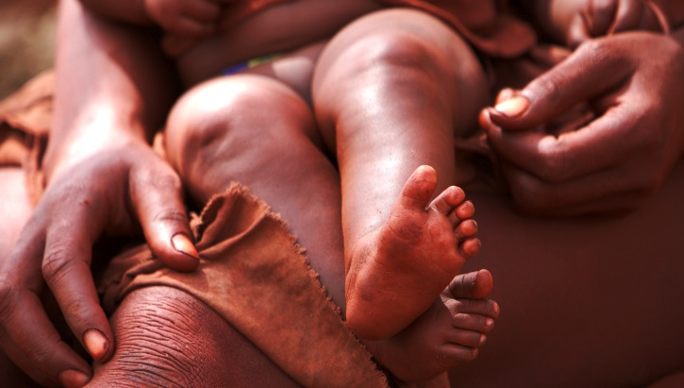
Cultural belief that a woman should not bathe for a month after childbirth?
Notes:
Living in conformity with cultural traditions often has gone on for centuries, with the reasons for certain behaviors and beliefs hidden in the mists of time. Many practices have absolutely no basis in fact. It’s not difficult to debunk the benefits of practices such as applying cattle dung to a newborn’s umbilicus, but possibly harder to argue convincingly with a cultural belief that a woman should not bathe for a month after giving birth.

Slide 17
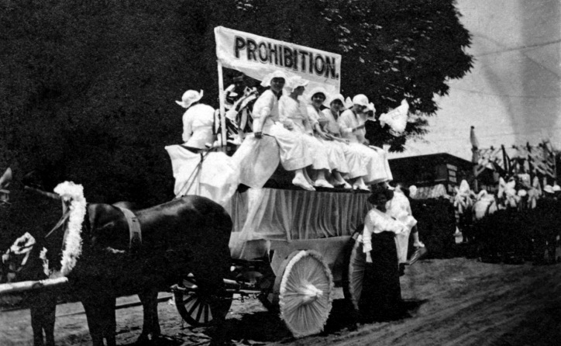
“Health reformers”
Notes:
In the first half of the nineteenth century, “health reformers” developed a litany of health laws based on scant evidence. Fortunately, today a wealth of evidence can guide us in making choices. Principles of balance and moderation, with the avoidance of harmful substances, will pay dividends in the health of temperate and informed people.

Slide 18



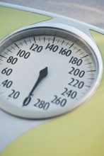
Lifestyle habits that influence longevity
1. Adequate sleep (7 to 8 hours per night)
2. No eating between meals
A nutritious daily breakfast
Maintenance of recommended body weight
Notes:
One of the early classic studies on lifestyle and health was published in 1972. Drs. Nedra Belloc and Lester Breslow, from the U. S. Department of Public Health in Berkeley, California, were among the first researchers to present convincing answers on lifestyle habits that promote longevity. In their study of 6,928 adult residents of Alameda County, California, they found that some lifestyle habits influenced longevity:²
1. Adequate sleep (7 to 8 hours per night)
2. No eating between meals
3. A nutritious daily breakfast
4. The maintenance of the recommended weight for one’s height, bone structure, and age (BMI, or Body Mass Index)

Slide 19
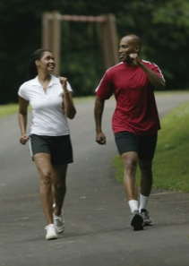
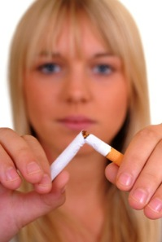
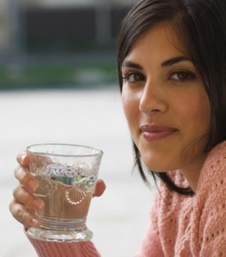
Lifestyle habits, continued
5. Regular physical activity
6. The nonuse of tobacco
An Abstinence to the use of alcoholic beverages
(the GC Health Department advocates abstinence)
Notes:
5. Regular physical activity
6. The nonuse of tobacco
A reduction in the use of alcoholic beverages (the GC Health Department advocates abstinence)
In a nine-year follow-up they showed that the more of these seven habits a person regularly followed, the greater their chance of longevity. Of the group following all seven habits, only 5.5 percent of men and 5.3 percent of women died before the end of the nine-year period; whereas in the group that followed only three of the seven habits, 20 percent of the men and 12.3 percent of the women died.³

Slide 20
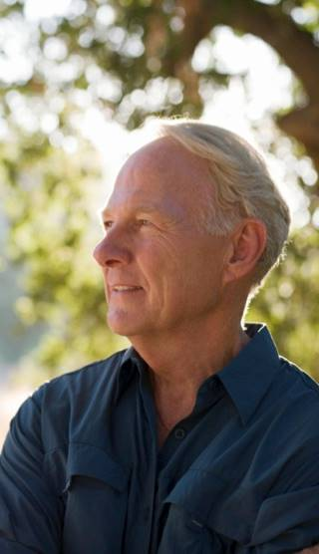
Stay objective
Common sense
Don’t make choices in midst of highly stressful situations
Anger, depression, and elation can influence decisions
Don’t assume things
Notes:
Even when clearly intentional, freely made, and informed, choices and decisions are not always easy to make, particularly when trying to maintain objectivity. So keep in mind the following:
Get the facts and weigh them on the scale of common sense.
When possible, don’t make choices in the midst of highly stressful situations, when it’s more difficult to think clearly.
Watch out for the distortion your emotional state can bring to decision-making. Anger, depression, and elation can influence decisions.
Don’t assume things. Just because sugar tastes good, it doesn’t mean it’s good for you. Similarly, something that tastes bad isn’t necessarily improving your health.

Slide 21
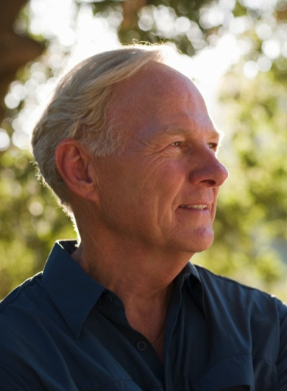
Beware of wishful thinking
Be careful where you get your health advice
Trust in intelligence
Choose to do what you can do, not what you want to do
Notes:
Beware of wishful thinking. Don’t overlook that lump because you wish it would go away. Don’t think you can walk a mile to get rid of the calories in a piece of coconut cream pie.
Be careful where you get your health advice. Quackery is still thriving in a multitude of guises.
Trust in intelligence; choose the smart over the unwise, the good over the bad. Also beware of the dead-end path that takes you nowhere.
Choose to do what you can do, not what you want to do. Our wants are often beyond us, and they are so many.

Slide 22

Adventists see good health as a gift from our Creator God. Even the best maintenance cannot guarantee a disease-free life.
Notes:
Adventists see good health as a gift from our Creator God. The proper “preventive maintenance” reduces risk and leads to a happier, healthier, and longer life. No one lives forever, though, and even the best maintenance cannot guarantee a disease-free life.

Slide 23

People choose their attitude
Notes:
Recent scientific studies also indicate the importance of spirituality to mental health. With anxiety disorders being the most prevalent of the emotional disorders, spiritual exercises such as Bible reading and meditation on the life of Christ can bring great peace—one of the ingredients of mental health.
For some, the quality of life is more important than its duration. There are chronically ill people who are happy and content, because they intentionally have chosen to make the best of their situation. Similarly, many who are perfectly healthy physically may nurture a negative mind-set that destroys their equanimity. People choose their “attitude,” and this affects the way they relate to triumphs or disasters—and many situations in between.

Slide 24

Faith
We have chosen to believe in God as our Creator and heavenly Father, even though we cannot see or touch Him. Having chosen to believe, a huge amount of supportive evidence may be amassed to support this belief. At its core, however, it’s a choice—the most important choice any person can make, because it’s only by developing and maintaining a close walk with our Lord that we will truly obtain optimal whole health and know the joy of living well, both here and throughout eternity.
Notes:
One area of choice, of course, is what we believe. Science does not illuminate all aspects of life, and so people live in or by a system of beliefs. Some call this “faith.” Many—including me, as the writer—have chosen to believe in God as our Creator and heavenly Father, even though we cannot see or touch Him. Having chosen to believe, a huge amount of supportive evidence may be amassed to support this belief. At its core, however, it’s a choice—the most important choice any person can make, because it’s only by developing and maintaining a close walk with our Lord that we will truly obtain optimal whole health and know the joy of living well, both here and throughout eternity.

Slide 25

LIFE APPLICATION QUESTIONS
Notes:
LIFE APPLICATION QUESTIONS

Slide 26
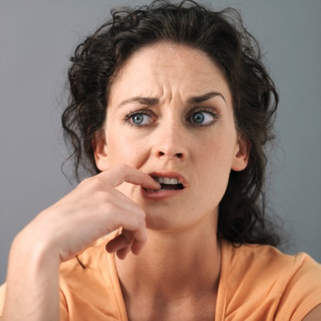
What choices am I making, consciously or unconsciously, that are not based on evidence?
Notes:
What choices am I making, consciously or unconsciously, that are not based on evidence?

Slide 27

How do these choices affect my use of time; my health; my relationships at work, at home, or with God?
Notes:
How do these choices affect my use of time; my health; my relationships at work, at home, or with God?

Slide 28
What are my reasons for making these choices?
Notes:
What are my reasons for making these choices?

Slide 29

In what ways are they influenced by my culture or my emotions?
Notes:
In what ways are they influenced by my culture or my emotions?

Slide 30
In what ways are they influenced by my culture or my emotions?
Is it because I wish to please myself or am I being careless?
Notes:
Is it because I wish to please myself, or am I being
careless?

Slide 31

Do I accept as evidence anything and everything I read on the internet?
Notes:
Do I accept as evidence anything and everything I read on the Internet?

Slide 32
Do I accept as evidence anything and everything I read on the internet?
Does just one anecdote convince me of the right thing to do?
Notes:
Does just one anecdote convince me of the right thing to do?

Slide 33

What negative choices have other people made that influenced the trajectory of my life?
Notes:
What negative choices have other people made that influenced the trajectory of my life?

Slide 34
What negative choices have other people made that influenced the trajectory of my life?
How have I reacted to those circumstances?
Notes:
How have I reacted to those circumstances?

Slide 35
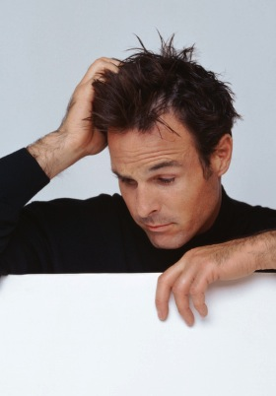
What freedoms do I enjoy that allow me to choose to change the direction in which I am heading?
Notes:
What freedoms do I enjoy that allow me to choose to change the direction in which I am heading?

Slide 36
What freedoms do I enjoy that allow me to choose to change the direction in which I am heading?
How can I choose to improve my attitude even under less-than-ideal circumstances?
Notes:
How can I choose to improve my attitude even under less-than-ideal circumstances?

Slide 37

How many of the seven habits that influence longevity am I practicing regularly?
Notes:
How many of the seven habits that influence longevity am I practicing regularly?

Slide 38

Am I getting sufficient sleep, exercising regularly, avoiding tobacco and alcohol, eating a good breakfast and not eating between meals?
Notes:
Am I getting sufficient sleep, exercising regularly, avoiding tobacco and alcohol, eating a good breakfast and not eating between meals?

Slide 39
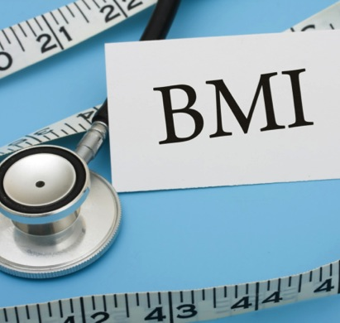
Is my Body Mass Index (BMI)
or weight to height ratio within recommended limits?
www.nhlbisupport.com/bmi for a handy calculator.
Notes:
Is my Body Mass Index (BMI) or waist to height ratio within recommended limits?
www.nhlbisupport.com/bmi for a handy calculator.

Slide 40

Which ones will I choose to introduce into my lifestyle today?
Could I improve on any of the seven?
Notes:
Which ones will I choose to introduce into my lifestyle today?
Could I improve on any of the seven?

Slide 41

Chris went out to a business dinner after a long day at work. Before leaving he was accused of something he had not done.
Notes:
Chris went out to a business dinner after a long day at work. Before leaving he was accused of something he had not done.

Slide 42

He later tells a friend that after a few drinks he relaxed and decided to resign his job, move to a different city, and look for work there.
Notes:
He later tells a friend that after a few drinks he relaxed and decided to resign his job, move to a different city, and look for work there.

Slide 43

What influenced his hasty decision?
Notes:
What influenced his hasty decision?

Slide 44
What influenced his hasty decision?
What did he forget to do?
Notes:
What did he forget to do?

Slide 45
What influenced his hasty decision?
What did he forget to do?
How would I have acted in a similar situation?
Notes:
How would I have acted in a similar situation?

Slide 46
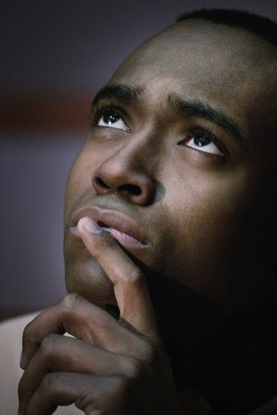
Remembering the most recent poor choices I’ve made and considering the pressures I was under at the time,
Notes:
Remembering the most recent poor choices I’ve made and considering the pressures I was under at the time

Slide 47
Remembering the most recent poor choices I’ve made and considering the pressures I was under at the time,
do I feel that I was stressed, angry, or depressed?
Notes:
do I feel that I was stressed, angry, or depressed?

Slide 48
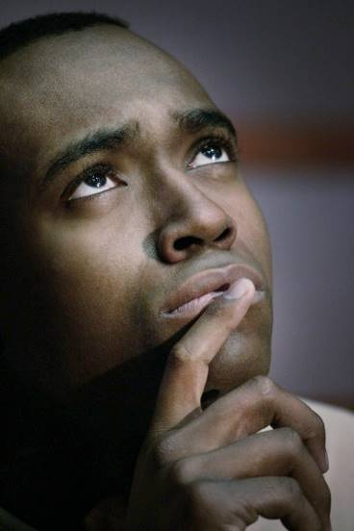
Did I make the decision late at night or after a heavy meal or after a long day of work?
Notes:
Did I make the decision late at night or after a heavy meal or a long day of work?

Slide 49

How can I remind myself to avoid making choices when in those type of emotional states?
Notes:
How can I remind myself to avoid making choices when in those type of emotional states?

Slide 50
How can I remind myself to avoid making choices when in those type of emotional states?
Did I remember to ask for divine guidance?
Notes:
Did I remember to ask for divine guidance?

Slide 51

What time of day suits me best for decision-making?
Notes:
What time of day suits me best for decision-making?

Slide 52
What time of day suits me best for decision-making?
What can I do when confronted with a small choice that will help me to make a wise decision?
Notes:
What can I do when confronted with a small choice that will help me to make a wise decision?

Slide 53
What time of day suits me best for decision-making?
What can I do when confronted with a small choice that will help me to make a wise decision?
What things would help me when making a big decision?
Notes:
What things would help me when making a big decision?

Slide 54

What choices do I have to make regarding my relationship with my Creator, who graciously gives me the freedom to choose?
Notes:
What choices do I have to make regarding my relationship with my Creator, who graciously gives me the freedom to choose?

Slide 55
What choices do I have to make regarding my relationship with my Creator, who graciously gives me the freedom to choose?
How can I increase my awareness of His love and His interest in my choices?
Notes:
How can I increase my awareness of His love and His interest in my choices?

Slide 56

Do I need to spend more time learning about Him in His Word or in nature?
Notes:
Do I need to spend more time learning about Him in His Word or in nature?

Slide 57
Do I need to spend more time learning about Him in His Word or in nature?
Do I have to cultivate my conversation with Him in prayer?
Notes:
Do I have to cultivate my conversation with Him in prayer?

